Slide 1
Payment Fraud Prediction
Nenad, Joe, Maria, Devan & Roger

Slide 2

Problem Statement - Purpose
The fraud data refers to information collected and analyzed to identify fraudulent activities, such as illegal
Financial Transactions
Embezzlement
Identity Theft
The problem is to be able to detect fraud and being able to protect institutions against financial losses. We want to ensure that legitimate transactions are not impeded.
This process will involve machine learning algorithms, and other tools to identify high-risk activities, and then implementing appropriate measures to prevent fraud from occurring.
Notes:
Maria

Slide 3



Problem Statement - Solution
Fraudulent activities can lead to financial losses, damage to reputation, and legal consequences for businesses that process online payments.
Detecting and preventing fraud is crucial for the success and sustainability of any online payment system.
The solution developed through this project can help businesses:
Reduce financial losses due to fraudulent transactions
Protect their reputation
Maintain customer trust
Comply with regulatory requirements
Avoid legal penalties
Notes:
Maria
Top 3 biggest financial fraud cases according to US News FTX launched as a trading platform for crypto investors in May 2019, with Bankman-Fried as its majority owner. Known universally now as SBF, Bankman-Fried had previously opened a hedge fund with a friend, Gary Wang, called Alameda Research LLC. In late 2022, the U.S. Securities and Exchange Commission accused SBF of defrauding his companies' investors by steering money from FTX into Alameda Research between 2019 and 2022. SBF and company executives allegedly used the cash to purchase homes in the Bahamas, invest in other companies and fund favored political causes. When crypto assets took a precipitous plunge in 2022, the cash spigot went dry at both FTX and Alameda – with the latter owing FTX customers about $8 billion, according to the Commodity Futures Trading Commission – and federal prosecutors stepped in to issue fraud charges.
Initially heralded as an innovative health care technology company, Theranos opened for business in 2003, with 19-year-old founder Elizabeth Holmes at the helm and a commitment to making the common blood test more efficient, more accurate and much faster. Flush with $700 million in equity investments, Theranos was valued at $10 billion by 2014. By 2015, however, the company's highly touted automated compact testing device was exposed as unworkable by medical testing professionals. Soon after, federal and state regulators filed fraud charges against the company. Crushed under the weight of legal costs, Theranos dissolved in 2018. Court battles ensued, and in November and December 2022, Holmes and the company's former president, Ramesh "Sunny" Balwani, were both found guilty and sentenced to more than 11 and 12 years in prison, respectively. Top-tier investors such as Rupert Murdoch, Carlos Slim and Betsy DeVos lost millions from Theranos investments, with little hope of getting the money back.
On Dec. 8, executives at Wirecard, a Munich, Germany-based electronic payments firm, went on trial in what media outlets called the biggest corporate fraud case in German history. Former CEO Markus Braun and two senior executives, Oliver Bellenhaus and Stephan von Erffa, all face multiple years in prison if convicted. Another highly placed Wirecard executive, Jan Marsalek, is on the run after leaving the country and is reportedly hiding out in Russia. Currently, Marsalek is atop Germany's "most wanted" list. Wirecard found itself in the spotlight when it declared insolvency in 2020 after authorities discovered $1.9 billion was missing from the company's accounts amid allegations from German regulators that the money never existed at all. Consequently, Braun was arrested and Marsalek fled the country.

Slide 4
Data & Definitions
This is a dataset containing information about online payment fraud, so that we can understand what type of transactions lead to fraud.
This contains historical information about fraudulent transactions which can be used to detect fraud in online payments.
Original Data:
step: represents a unit of time where 1 step equals 1 hour
type: type of online transaction
amount: the amount of the transaction
nameOrig: customer starting the transaction
oldbalanceOrg: balance before the transaction
newbalanceOrig: balance after the transaction
nameDest: recipient of the transaction
oldbalanceDest: initial balance of recipient before the transaction
newbalanceDest: the new balance of recipient after the transaction
isFraud: fraud transaction (target)
Original Data at a Glance
Number of Records - 100000
Number of Features - 11
Target Feature - IsFraud: 0 (Not Fraud), 1 (is Fraud)
3 Categorical features , 7 continuous , 1 Binary
Notes:
Devan

Slide 5
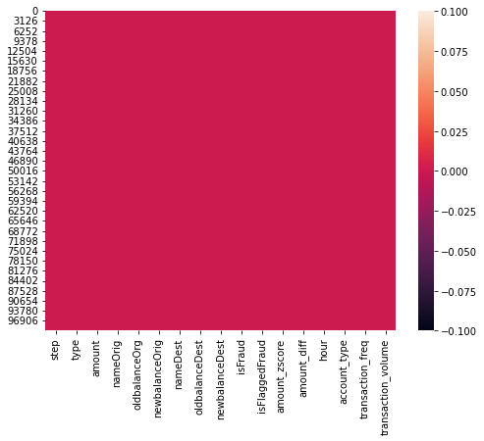
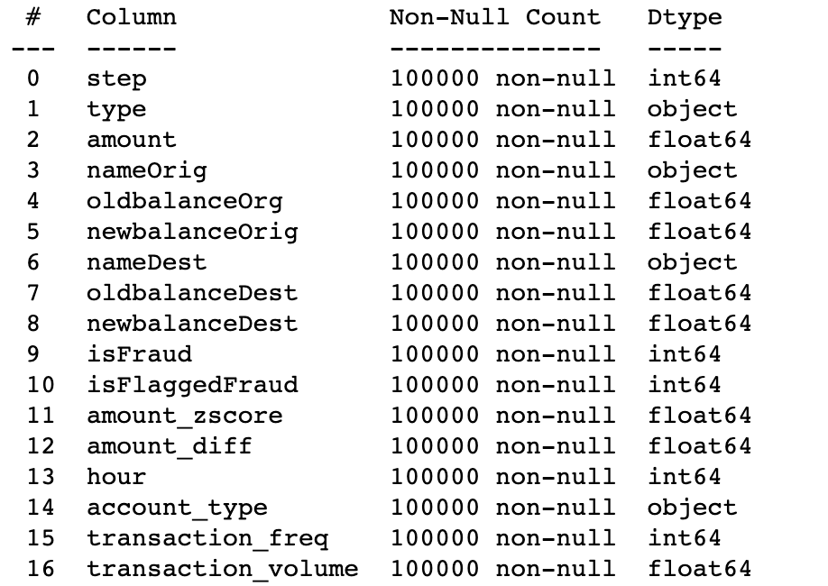
EDA
Our original dataset had 11 columns (0-10 in the right diagram) after feature engineering we added features 11-16 resulting in 17 total columns
We can see that all the data is populated and we have no issues with null values
Exploring the data further we took into account the different data types available to us for later EDA
Notes:
Devan
df['amount_diff'] = df['oldbalanceOrg'] - df['newbalanceOrig']
df['hour'] = pd.to_datetime(df['step'], unit='h').dt.hour
def account_type(name):
if name.startswith('C'):
return 'customer'
elif name.startswith('M'):
return 'merchant'
else:
return 'unknown'
df['account_type'] = df['nameOrig'].apply(account_type)
freq = df.groupby('nameOrig')['step'].diff().fillna(0)
df['transaction_freq'] = freq.apply(lambda x: 1 if x == 0 else 1/x)
df['transaction_volume'] = df.groupby('nameOrig')['amount'].cumsum()

Slide 6
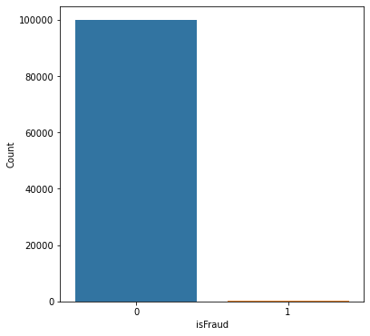
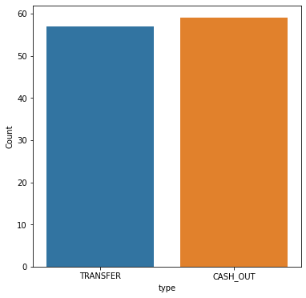
EDA
Fraud has happened only in cash out and transfer type.
0.667% of all Cash Out transactions where fraudulent
0.192% of all Transfer transactions where fraudulent
Of all 100,000 transactions 0.12% where fraudulent
Notes:
Roger

Slide 7
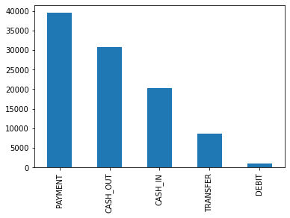
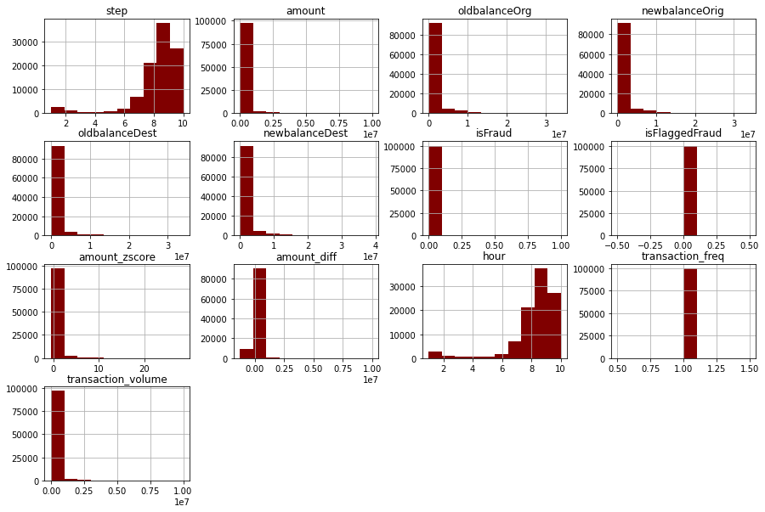
EDA
Looking at the distributions we can see that there is skewness in both step and hour features
We need to look further into the distribution that are not clearly viable
More money has been transacted mostly through Payment type followed by cash out type
Notes:
Roger

Slide 8
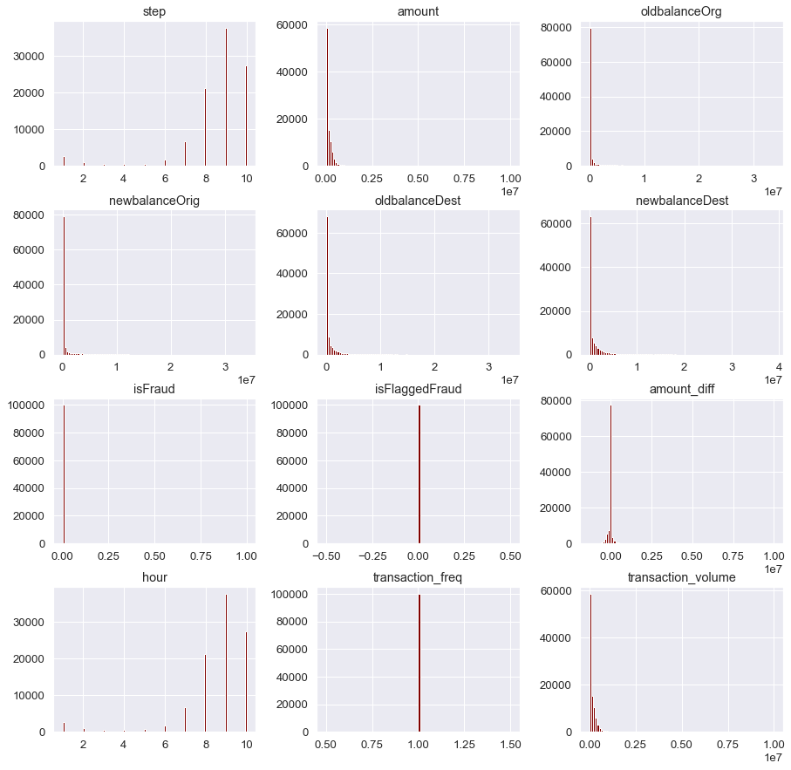
EDA
After looking closer we see more skewness for other metrics in our dataset
Notes:
Roger

Slide 9
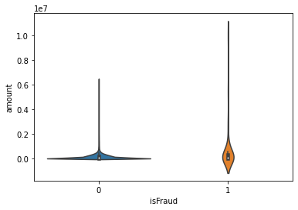
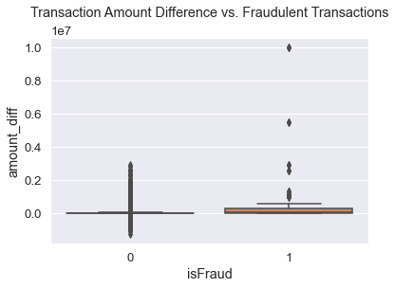
EDA
Both charts on the right are looking at Fraud where 0 is not a fraud and 1 is a fraud
We are looking at the amount of the transaction for fraud and not fraud transactions using a violin plot. We can see that fraud transactions have a higher density and range than non fraud transactions
On the bottom right we can see that dispersion of amount difference for fraud and not fraud transitions with the fraud transactions having more outliers and higher density, similar to the violin plot
Amount difference is the difference between the old balance and the new balance
Notes:
Joe

Slide 10
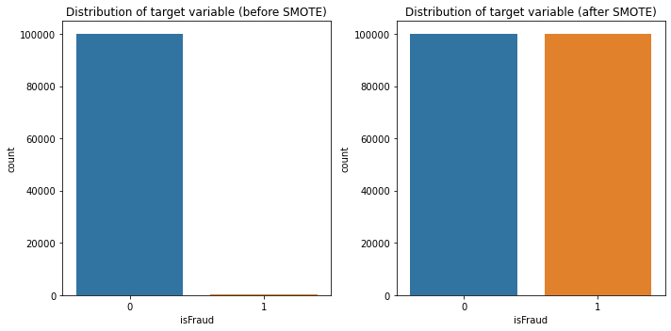
Balancing Data
We use SMOTE to balance our data set
Synthetic examples are generated for the minority class by creating new data points that are combinations of existing minority class examples
This is done by identifying k nearest neighbors from the minority class for each minority class example, and creating synthetic data points along the line segments joining these neighbors.
Notes:
Joe
We are assuming KNN is not introducing any bias to the data

Slide 11
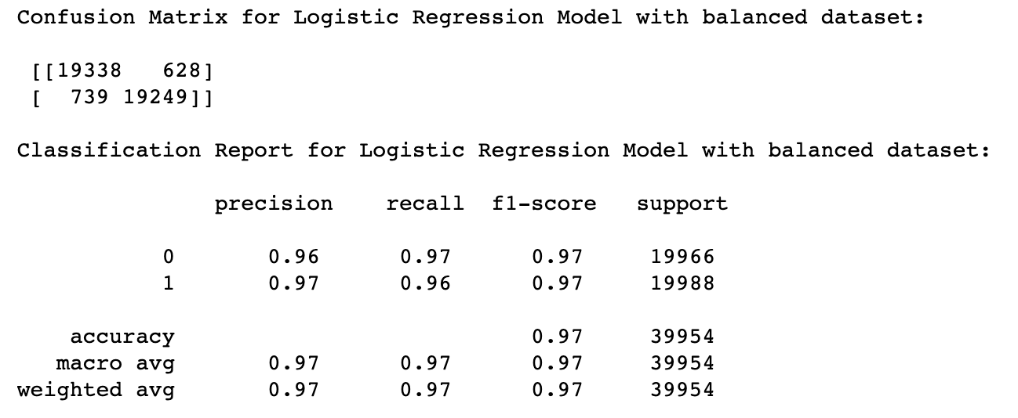
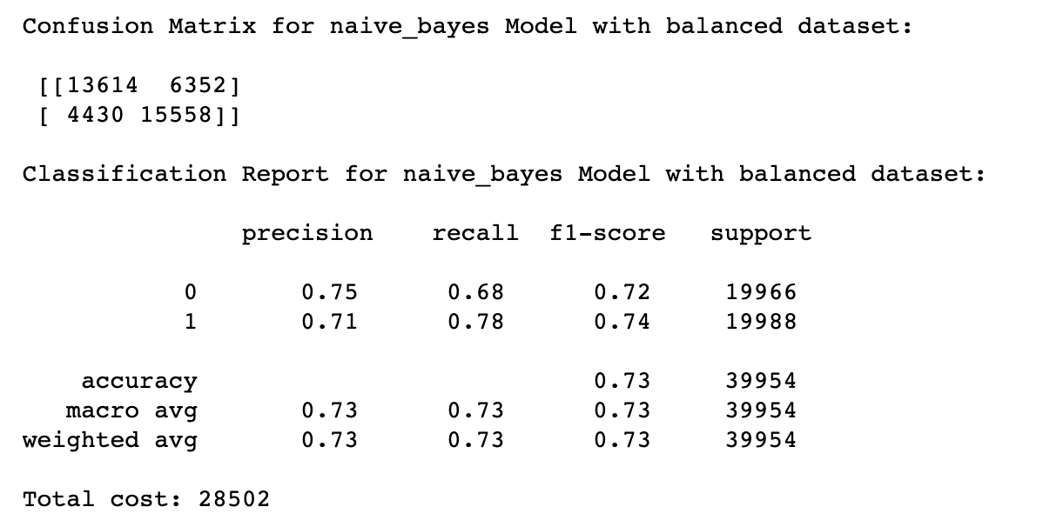
Methodology
Logistic regression performs well in the recall
It also has a good confusion matrix with good predictions on type 2 errors
Naive Bayes performs well in the recall, however not as good at logistic regression
It also has a good confusion matrix with good predictions on type 2 errors
Notes:
Nenad

Slide 12
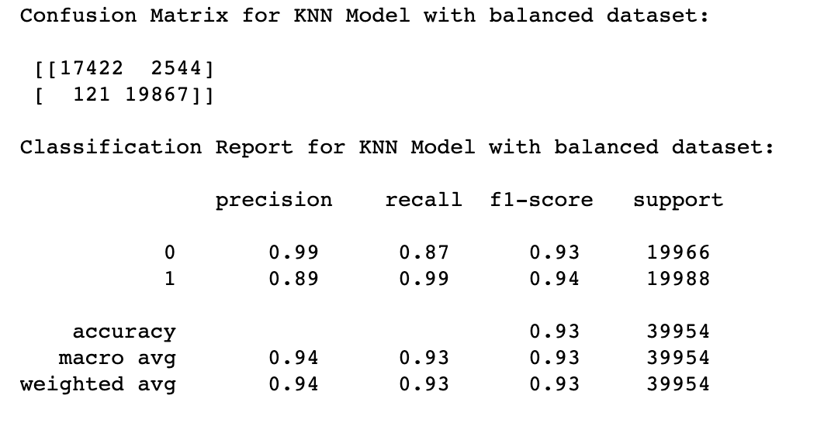
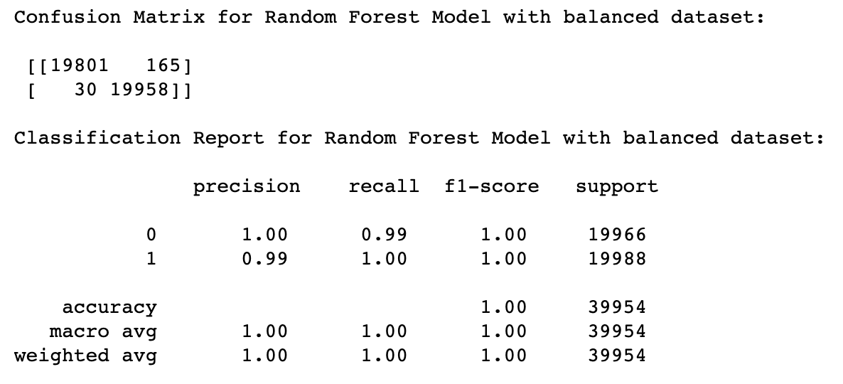
Methodology
KNN Model performs well in the recall and better than naive bayes and slightly better than logistic regression
It also has a good confusion matrix with good predictions on type 2 errors, also better than Logistic Regression
Random Forest performs the best in the recall
It also has a good confusion matrix with the best predictions on type 2 errors out of the models tested
Notes:
Nenad

Slide 13
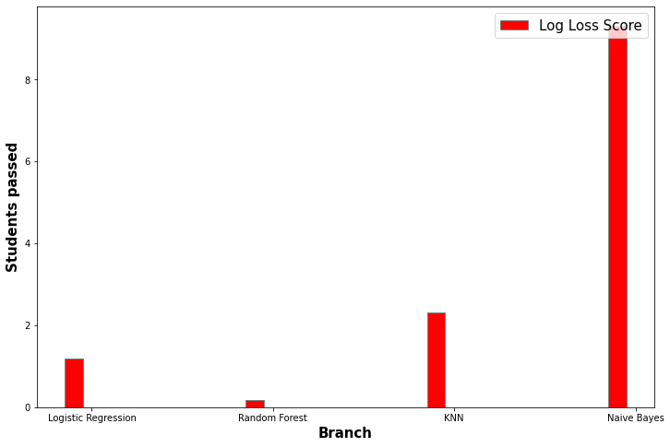
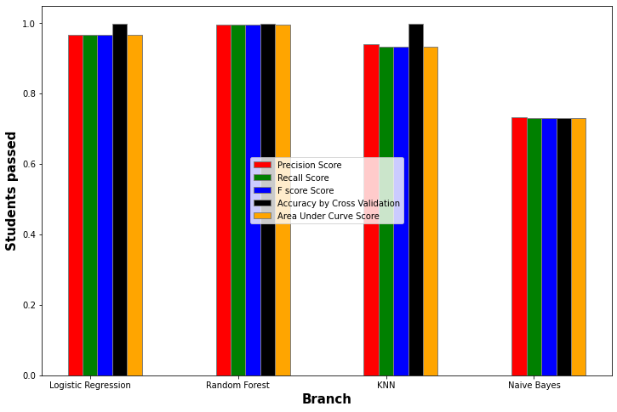
Results and Conclusions
Random Forest has the lowest Log Loss as shown below
Log Loss measures the performance of a model by calculating the difference between the predicted probability distribution and the actual probability distribution.
Random Forest also has the highest recall score
A high recall score means that the model is correctly identifying most of the positive instances in the dataset
Notes:
Nenad
The lower the log loss, the closer the predicted probabilities are to the actual probabilities, and therefore, the better the performance of the model.

Slide 14
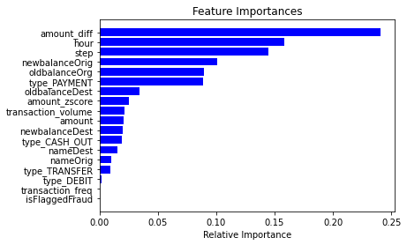
Results and Conclusions
The random forest model's mean accuracy score after cross validation on training dataset is 0.9992
The evaluation accuracy score for random forest is 0.9993
The percentage difference between cross validation and evaluation is -0.0001, meaning our model is not overfitting or underfitting
Our Feature Importances is being calculated from the best model we have tested, Random forest
Notes:
Nenad

Slide 15
Thank you!

